Slide 1
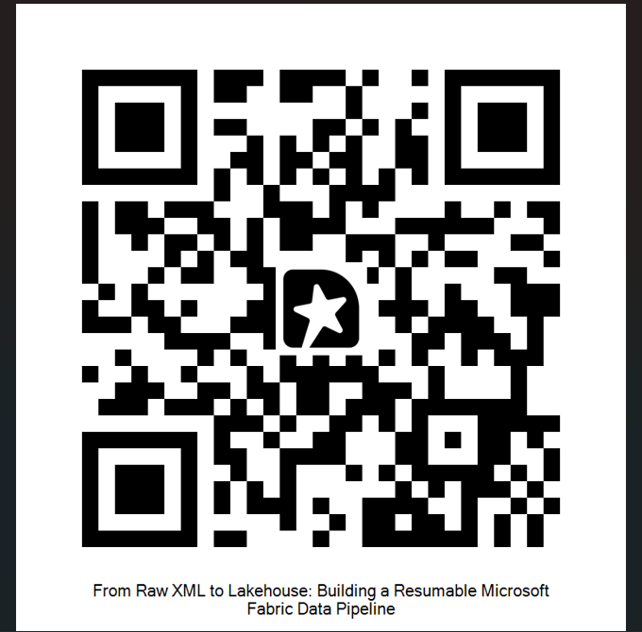
CONGRESS119
Machine Learning for Legislative Intelligence
Feedback
Predicting, explaining, and mapping the path of a bill through the 119th Congress
Chad Nelson | Senior Data and Analytics Consultant (Link to LinkedIn Page)
cnelson@teamscs.com
nels2248@gmail.com
Live Power BI Dashboard Link
Live dotnet Web App (may require a few clicks as it goes cold) Link
Github Repo of Fabric Setup
Github Repo of Azure Functions/dotnet App Link

Slide 2
CONGRESS119
Machine Learning for Legislative Intelligence
AGENDA
Story Time
Who Am I / What this Project Does
What data shows
Nightly Processing
Dashboard/Scripts/Machine Learning
  Clustering
  Network Graphs
  Prediction
Co Pilot
Long Term Vision
Feedback

Slide 3
INTRODUCTION
Who I Am & What This Project Does
Who I Am
What This Project Does
Senior Data and Analytics Consult at Superior Consulting Services with over 20 years experience across various industries
Using Microsoft Fabric more frequently for end to end solutions.
Completed a Master of Data Science in August from North Dakota State University (NDSU)
End-to-end pipeline ingesting live 119th Congress bill data from GovInfo.gov
Microsoft Fabric medallion architecture — Bronze, Silver, and Gold Delta Lake layers
Power BI dashboards on DirectLake for near real-time exploration
A machine learning layer on top that predicts, explains, and maps legislative behavior — the focus of this deck
Long term vision to move off Microsoft Fabric and use Azure Database, Python in Azure Data Functions, dotnet Web App

Slide 4
INTRODUCTION
What data does this show?
D
Data
S
Standard Items for Each Bill
https://www.govinfo.gov/bulkdata/BILLSTATUS/ files - Tried the API but kept timing out and since refreshing nightly went this route.
Data for Each Bill
  Actions
  Co Sponsors
  Amendments
  Committees
  Related Bills
  Summaries
  Titles
Title
Text of Bill
Sponsor
Policy Area
Status
02

Slide 5

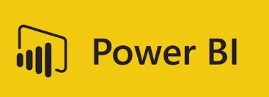
DATA SET
Nightly Processing
Get data (Step 1)
Lakehouse files
Step 4
Machine Learning (Step 2)
Lakehouse SQL
Step 3

Slide 6
ARCHITECTURE
How It All Fits Together
Bronze
Silver
Gold
ML Layer
Power BI and Copilot
Raw BillStatus XML from GovInfo.gov
Normalized, deduplicated tables
Feature views ready for ML & BI
Random Forest · SHAP · Network · Clustering
DirectLake dashboards for clients
The medallion architecture (Bronze → Silver → Gold) feeds a Gold-layer feature table that all four ML components read from — keeping predictions, explanations, and graph structure consistent with what's on the dashboard.
08

Slide 7
THE FOCUS OF THIS DECK
The Machine Learning Layer
Four models working together on Gold-layer bill data to predict outcomes, explain them, and reveal structure in how Congress operates
1
2
3.1
1
3.2
Clustering
Network Graph
Random Forest
SHAP Values
Surfaces topics
Maps relationships
Predicts bill outcomes
Explains Outcomes
03
Explains predictions

Slide 8
MODEL 1 · STRUCTURE
Clustering — Topic Discovery in Bill Text
1
Groups bills by what they're actually about, independent of their official policy_area tag
How it's built
Why it matters
KMeans clustering on bill summary text
Distinct from policy_area: clusters emerge from the language of the bill itself, not a fixed taxonomy
Cluster assignment stored per bill for exploration in Lakehouse alongside the RF prediction and SHAP explanation
Bills often span more than one policy area. Clustering exposes those overlaps and mislabeled categories that the official taxonomy hides.
07

Slide 9
MODEL 2 · RELATIONSHIPS
Network Graph — Cosponsor Relationships
2
Maps how legislators connect through shared bill sponsorship, and scores who sits at the center of it
How it's built
Why it matters
Nodes = legislators (or bills); edges = cosponsorship relationships
Centrality measures — degree and betweenness — identify influential legislators and bridge bills that connect otherwise separate coalitions
Rendered as a Force-Directed Graph visual in Power BI, connected via DirectLake
Graph Shown in PowerBI
Centrality surfaces the bipartisan bridge-builders and coalition brokers that a simple bill-count leaderboard would miss entirely.
Different Measures
Degree centrality — how many other members a given legislator has cosponsored bills with (or been cosponsored by). High degree = broadly connected, works across many relationships. This is the simplest one and just counts direct edges.
Betweenness centrality — how often a member sits on the shortest path between two other members who aren't directly connected. High betweenness = a "broker" or bridge, often someone who connects otherwise separate blocs (e.g., a moderate who bridges party factions, or a committee chair who links subgroups).
Eigenvector centrality — connectedness weighted by how well-connected your connections are. High eigenvector score = you're linked to other highly influential members, not just lots of members. This tends to surface party leadership and senior members who cluster together.
06

Slide 10
MODEL 3 · PREDICTION
Random Forest — Bill Predictions
3.1
Predicts whether a bill will pass its chamber of origin, pass the other chamber, or be enacted into law
How it's built
Why it matters
Target: multi-stage progression built from latest_action_text — referred, passed_house, passed_senate, enacted
Categorical features: bill_type, sponsor party, policy_area, origin_chamber
Numeric features: committee_count, action_count, cosponsor_count, amendment_count, related_bills_count, subjects_count, text_versions_count, title_count
StringIndexer + OneHotEncoder + VectorAssembler feed a single Spark ML pipeline
A calibrated pass/fail probability for every active bill turns a static tracker into a forward-looking signal — useful for clients watching legislation that affects their industry.
04

Slide 11
MODEL 2 · EXPLAINABILITY
SHAP Values — Why the Model Says What It Says
3.2
Turns the Random Forest from a black box into a defensible, feature-by-feature explanation
Two levels of explanation
Why it matters
Global importance: ranks which features move predictions across all bills — a first read on what actually drives passage
Local (per-bill) explanation: a waterfall view of exactly why one specific bill scored high or low
Sign matters as much as magnitude — a feature can push a prediction up or down, not just indicate importance
Computed once per model run and stored alongside predictions in the Gold layer for dashboard use
Clients don't just want a probability — they want the reasoning behind it. SHAP is what makes a prediction defensible in a client conversation, not just a black-box number.
Action Count
TOP DRIVER
05

Slide 12
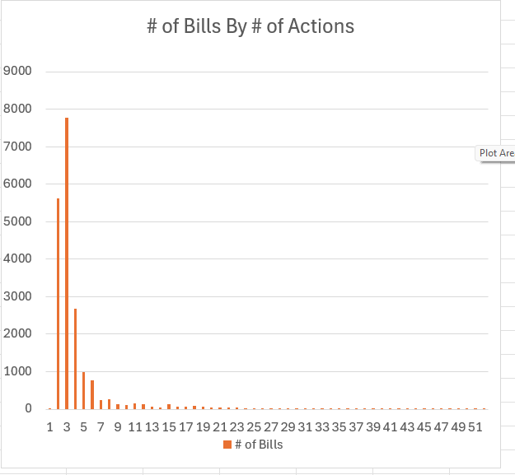
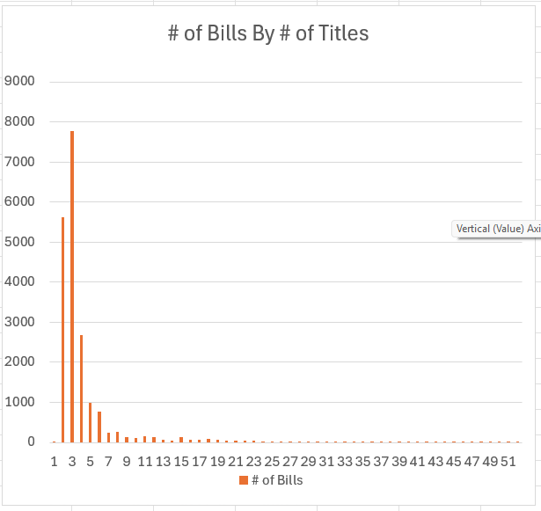
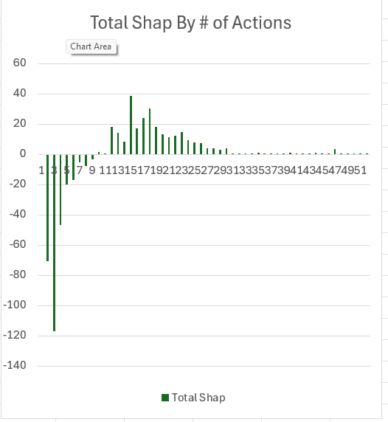
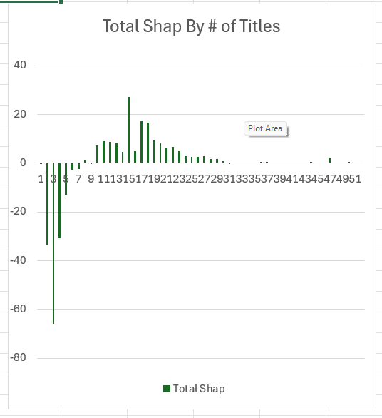
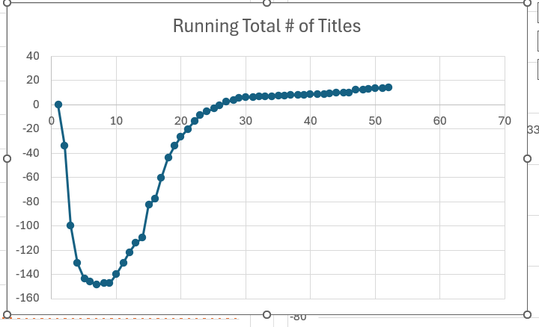
# Actions and # Titles Further Explanation
Confused me at times – Good example of overfitting and can be misleading. Short story, large amount of bills with few actions that don’t pass push it down. The # of Titles does get above 0 while # of actions does not.
Why it matters
WITH per_bill AS (
SELECT bill_id, COUNT(*) AS action_count
FROM congress_silver.actions
GROUP BY bill_id
)
SELECT LEAST(p.action_count, 51) AS action_count,
COUNT(*) AS bills,
ROUND(AVG(s.shap_value), 4) AS avg_shap
FROM per_bill p
JOIN congress_gold.bill_shap_values s
ON s.bill_id = p.bill_id AND s.feature = 'action_count’ – change to title_count to get title charts
GROUP BY LEAST(p.action_count, 51)
ORDER BY action_count;
05

Slide 13
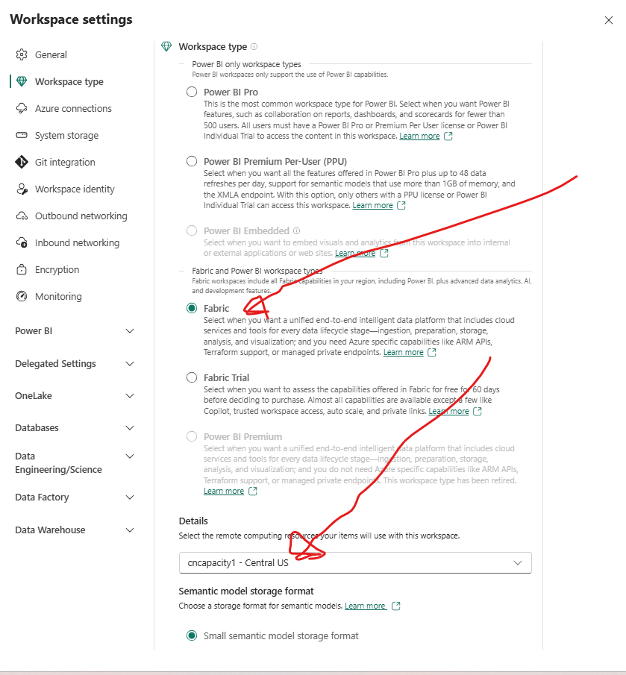
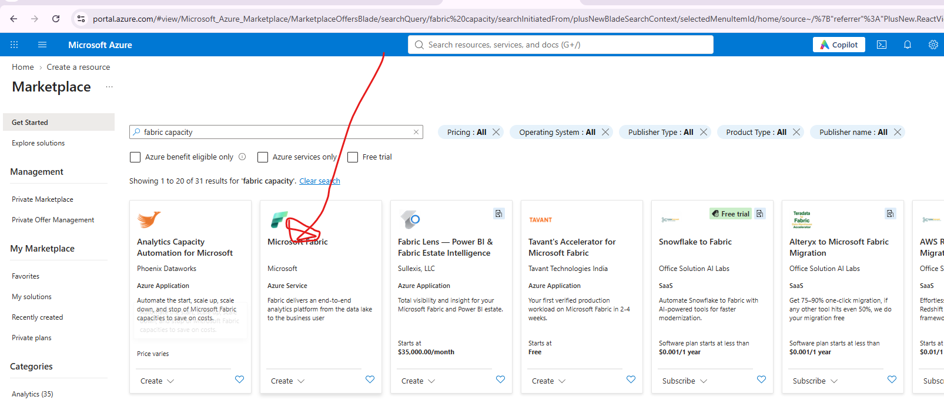
Fabric
Why it matters
Be able to ask questions of data without having to understand Power BI/data structure/web page layouts.
Ask questions the way a human would ask
Fabric Copilot Integration
Setup
Need to turn on
Need a Fabric Capacity enabled to use and Workspace Type set to Fabric and Capacity selected
Change workspace type to Fabric and select capacity
TOP DRIVER
05

Slide 14
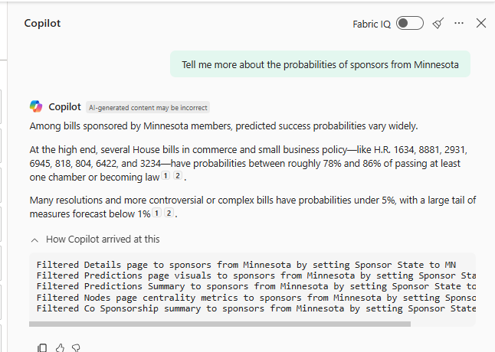
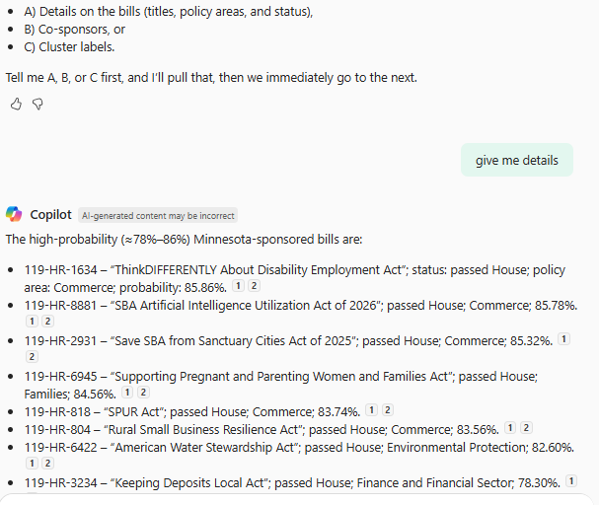
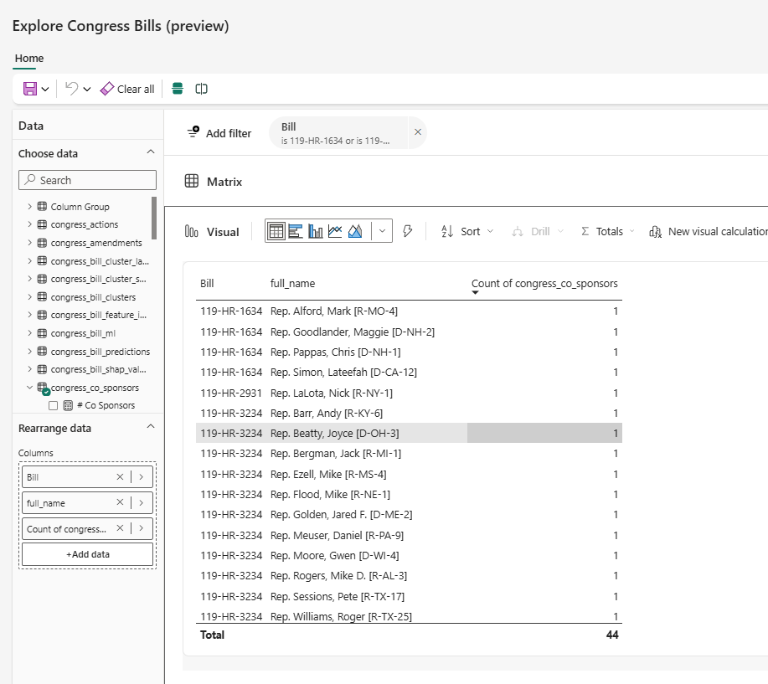
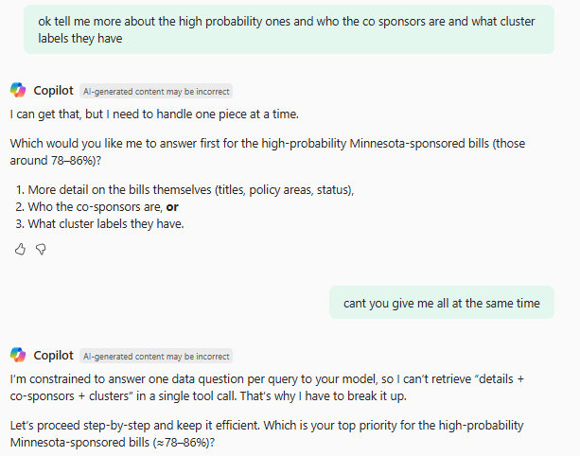
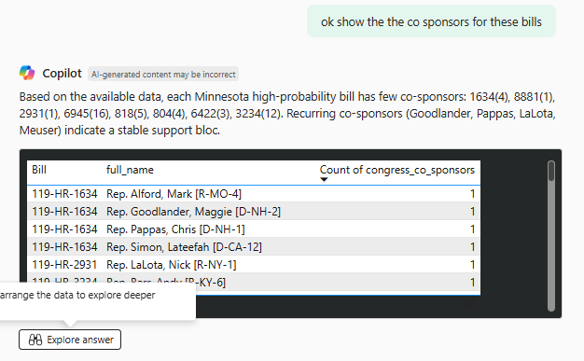
Fabric
Fabric Copilot Integration
Why it matters
Demo – Question 1
05

Slide 15
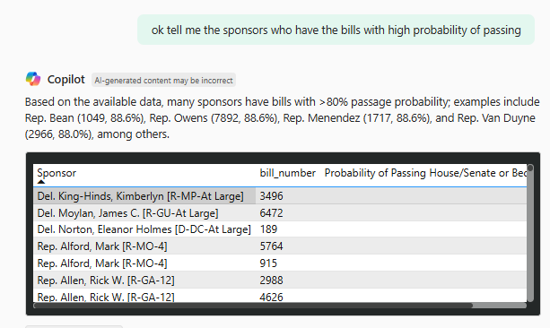
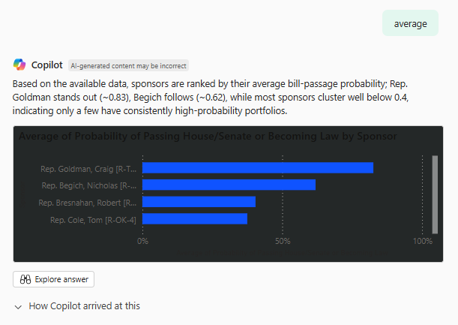
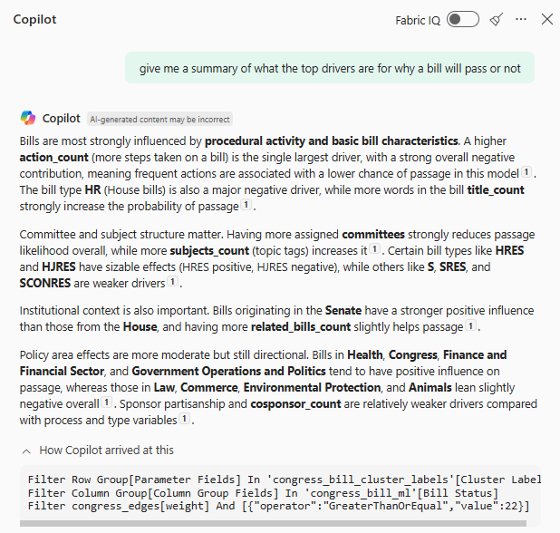
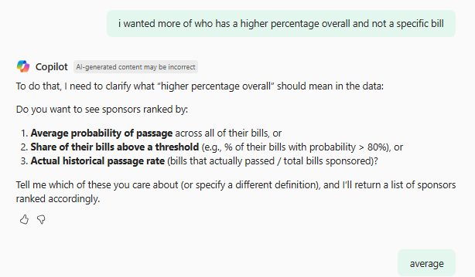
Fabric
Fabric Copilot Integration
Why it matters
Demo – Question 2
05

Slide 16
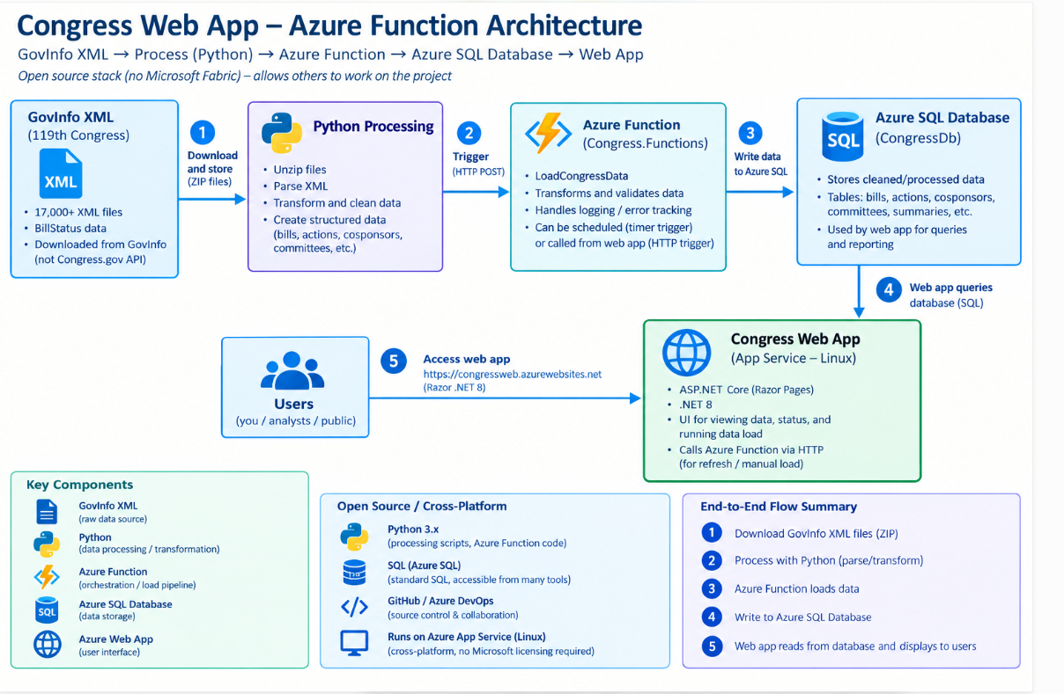
DOTNET AZURE FUNCTIONS
Created because want to make this more open source and a long term project that is live on web and not tied into Microsoft Licensing
Built with Azure Functions and dotnet web app. Hosted on Microsoft Azure
In Development
Currently having issues with nightly processing on production environment although runs fine locally.
Place I plan to continue to develop in. Send Pull request for this application if you would like to work on this with me.
Live dotnet Web App (may require a few clicks as it goes cold) Link
Github Repo of Azure Functions/dotnet App Link
05

Slide 17
KEY TAKEAWAYS
A Predictive, Explainable, Relational View of Congress
Predictive
Explainable
Relational
Structural
Prediction scores every active bill on its likelihood to pass or be enacted.
SHAP values turn each prediction into a feature-by-feature, client-ready explanation.
Network centrality surfaces the legislators and bills that bridge coalitions.
Clustering reveals the real topical shape of legislation, beyond fixed tags.
Chad Nelson | Senior Data and Analytics Consultant (Link to LinkedIn Page)
cnelson@teamscs.com
nels2248@gmail.com
Feedback
Live Power BI Dashboard Link
Live dotnet Web App (may require a few clicks as it goes cold) Link
Github Repo of Fabric Setup
Github Repo of Azure Functions/dotnet App Link
09

